Slide 1
Design Components
Lecture 8a
Mobile Computing

Slide 2
Designing an Application:What can go wrong?
Target audience not good at describing needs and developers don’t know how to determine them.
Developers don't understand the domain or terminology.
Target audience don't know what they need when things are new and novel.
Funding source is not the user: pressure to satisfy them, not the target audience.
Novelty (h/w, s/w, PL) provides unknowns that are not well understood.
System is complex and confusing: may be large and have many parts.

Slide 3
What developers think of the target audience …
Don't know what they want
Cant explain what they want
Unable to provide sufficient detail
Too many needs
Needs are politically motivated
Changing needs
Can't prioritise needs
Unwilling to compromise
Unable to take responsibility
Unwilling to commit to the project

Slide 4
What users think of developers…
Don't understand the domain
Can't merge the various needs into a coherent system
Unrealistic standards/need for precision
Too much emphasis on technical issues
Slow, unable to respond to change
Taking too long, costing too much, producing too little
Always saying "no" or "can't do that"
Expecting too much of the users
Think they know more than the user does

Slide 5
Techniques to Apply
Review procedures manuals and other documentation
Examine existing (or similar) systems
"Apprentice" as a user
Interview and observe users
Apply domain specific strategies (e.g., relational modelling)
Hire/use market researchers

Slide 6
Good Design Characteristics
Correctness, Feasibility, Testable
We can program the right thing and can check that we did
Consistency (Accuracy)
The design isn’t filled with mistakes or contradictions
Ambiguity and Completeness
Programmers don't have a ton of questions
Relevance and Traceable (Concise)
No extra confusing, unneeded garbage

Slide 7
What do I want to see?
I want to see a complete and through analysis of your data (both runtime and persistent).

Slide 8
ER Modelling (The basis of UML)
Chen (1976), Database focused
Entities: Things with (optional) attributes
Relationships: Associations between entities with (optional) attributes
Attributes: Properties with values that describe and identify entities and relationships
No “Right” answer – models reflect needs and viewpoints (e.g., is name an attribute of an employee or is it an entity that is related to an employee?)
But usually a “Best” answer – some models better than others
As much an Art as a Science – a good model is typically simple, intuitive, clear, and elegant, “as complex as it needs to be and no more”

Slide 9
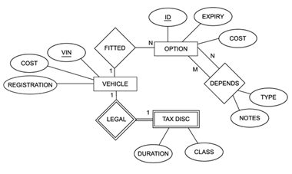
Example: ER Diagram

Slide 10
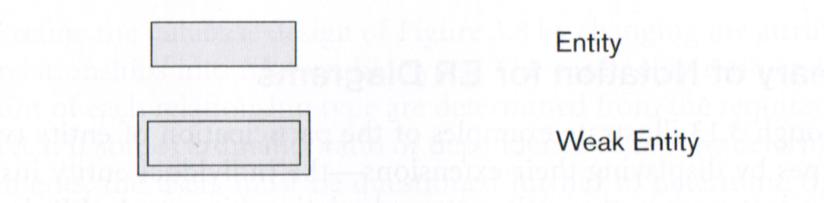
Notation: Entities
We sometimes need to identify a specific instance of an entity (i.e., there are many unique instances)
Example: A bank account – all are unique and have keys (i.e., account numbers)
An entity type for which no key exists is known as a Weak Entity
Example: Federal tax rate – there is usually just one

Slide 11
Attributes
Describe the properties of an entity or relationship
May be Composite or Simple (Atomic): Simple have one-part values and composite have multipart values
Simple: account Balance = 144
Composite: date = 17 January 2011 (d/m/y)
Choice depends on functional needs: e.g., name may be composite (first, middle, last) if each component is searchable, or simple if it is never decomposed
May be Stored or Derived (e.g., calculated using other attributes, possibly from other entities or relationships)
age can be stored as a value (57 years)
age can be derived (calculated) based on a stored birthDate (more accurate, does not need to be updated)

Slide 12
Attributes (continued)
May be Single-Valued or Multi-Valued
Single: age – everyone only has one
Multi: degrees – some people have more than 1 (e.g., 2 Bachelors, MMath, PhD, LLD)
May be optional/unknown – NULL Valued (e.g., degrees = NULL if someone doesn’t have one)
Note: NULL is a poor substitute for “none” and in good designs is not used this way. Avoiding NULL and explicitly coding “missing” is even better.
Composite and Multi-Valued attributes may be Complex (nested):
e.g., address may have a phoneNumber which has an areaCode
Nest/Aggregate something if its (almost) ALWAYS a component and (usually) NEVER used independently, e.g., phoneNumber is not a good choice to nest inside an address but postalCode should be part of address since its almost never independent

Slide 13
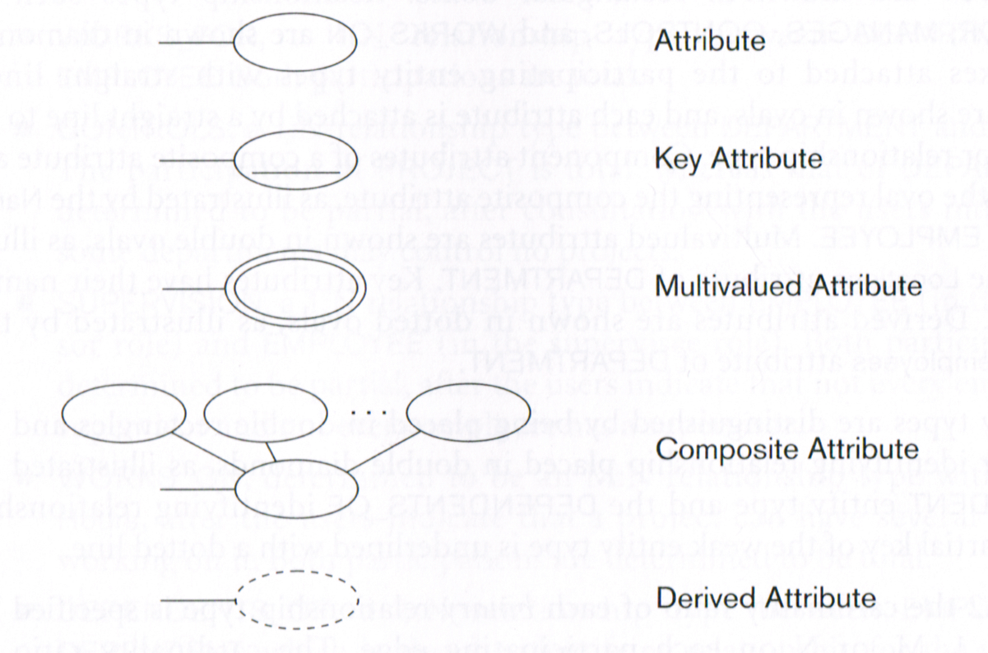
Notation: Attributes

Slide 14
Relationships
Informally, a relationship is an association between a set of entities
Relationship Type: a set of associations among entities (e.g., worksFor is a (binary) Rel. Type between the Entity Types employee and department) – frequently we leave off the word “type”
Relationship Instance: a n-tuple of entity instances, e.g., (e₁₂₃₄, d_{math&cs}) is an instance of worksFor, where n is the degree of the relationship
Relationship Set: a set of relationship instances, e.g., {(e₁₂₃₄, d_{math&cs}), (e₃₃₄₅, d_{psych}), (e₁₂₅₅, d_{bio})}

Slide 15
Cardinality (not critical)
The maximum number of entity instances that can participate in a particular relationship instance
Presented as a ratio, usually one of 1:1, 1:N, N:1, M:N
If relationship worksFor with instances (employee, department) is N:1 then an instance of the relationship can have at most N instances an employee and at most 1 instance of department
Can be extended beyond binary relations (e.g., N:1:1 for parents with roles (child, mother, father))

Slide 16
Participation Constraints (not critical)
MINIMUM number of relationship instances that an entity instance MUST participate in
Complement to cardinality (MAXIMUM relationship instances an entity instance MAY participate in)
Referred to as total participation (or an existence dependency) if EVERY entity instance must participate in 1 (or more) relationship instances
If participation is not total, then it is referred to as partial (only some entities will participate in the relationship)

Slide 17
Relationship Attributes
Relationships may have attributes
Attributes for relationships are often better treated as entity attributes (easier to understand) if an entity can only participate in 1 relationship instance
May migrate attribute to the entity, such that:
1:1, either entity may have the attribute
1:N or N:1, the attribute goes to the N-side
M:N, very complex as attribute value may depend on both entity instances – often not migrated

Slide 18
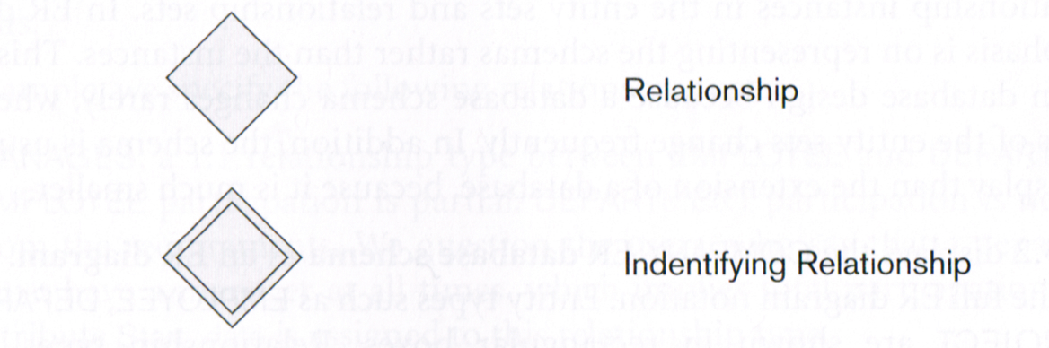
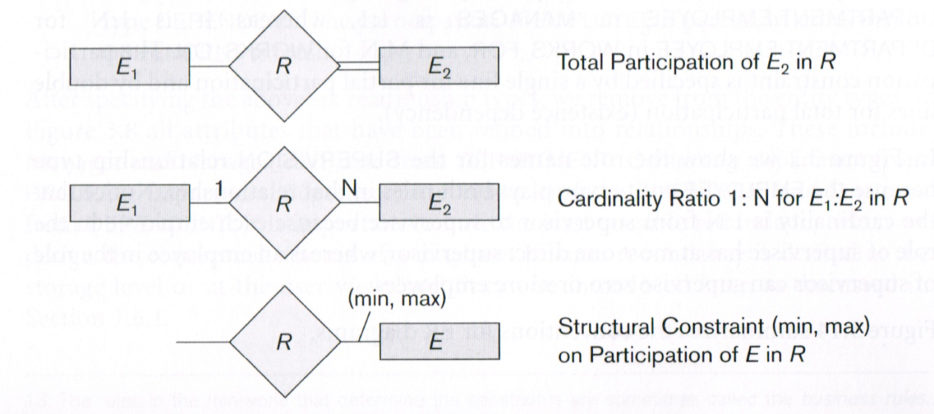
Notation: Relationships

Slide 19
Example: ER Diagram

Slide 20
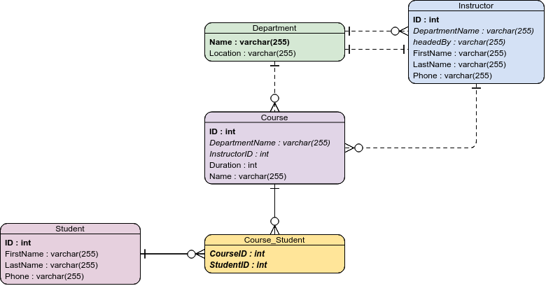
ER Diagram (Crow’s Foot Notation)

Slide 21
Keys to a GOOD Model
No redundancy: Everything exists once and only once.
Clarity: You should be able to look at the model and it should make sense.
Simplicity: Avoid anything unnecessary (e.g., do you really need to have both a phone number and an area code); K.I.S.S.
Good DB have lots of small tables with many relationships. Bad DB have large tables with few relationships.

Slide 22
Completeness
A good model is complete – all the data is shown, even data not stored in a database.
A good diagram is almost never complete – too much in one diagram often creates “information overload.”
A good model therefore needs many diagrams, each focusing on specific areas of the model.
Models and diagrams are used differently by different people (e.g., managers, developers, users) – a diagram typically has a specific target audience (e.g., it is intended to explain the system to a user/client).
No diagram shows everything in a way everyone can understand but the MODEL must show everything, somewhere. Nothing should be omitted.

Slide 23
UML
Is a diagrammatic framework for modeling systems
Has both syntax and semantics
Has formal specifications
Can be executed (MDA; Model Driven Architecture)
Is NOT a process – it is to support S.E., not replace existing practices
Can be used in multiple ways, including informally, and is easily extended
Is generally associated with OOP but can be used for other paradigms

Slide 24
Power of Practicality
Unless being used formally (e.g., Rhapsody, MDA), UML is designed to improve communication.
If something adds confusion (and harms communication), don’t use it.
Your diagrams should describe constraints, not impose them.
Do not let UML limit your thinking, perspectives, analyses, or designs.
Use it as you need, when you need, how you need.

Slide 25

References
http://en.wikipedia.org/wiki/Unified_Modeling_Language
Dan Pilone & Neil Pitman (2005).UML 2.0 in a nutshell: A desktop quick reference, O'Reilly Media Inc.: Sebastopol, CA, USA.
O’Reilly has lots of other good books on UML (Learning UML 2.0, UML Pocket Reference)

Slide 26
Uses
Capturing and communicating business processes (domain modeling)
Capturing details about a system for requirements or analysis
Designing software
Documenting existing systems, software, processes, or organizations
UML can be used anywhere in development for diagrammatically describing and communicating

Slide 27

Some Observations …
Nearly everything in UML is optional
UML models are rarely complete
UML is designed to be open to interpretation (different organisations use it differently)
UML is intended to be extended
UML is a framework, a set of guidelines, a tool for communicating and explaining things
While it can be formal, it doesn't have to be if the formality doesn’t help the communication and explanation

Slide 28
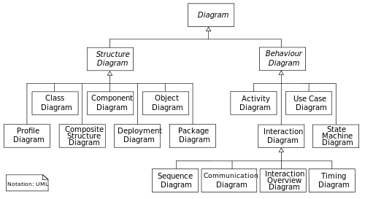
Hierarchy of UML Diagrams

Slide 29
UML Structural Diagrams
Perform static modeling
Describe the structure of the system, its design, components, parts, pieces
Includes attributes and relationships
Most of these diagrams can be subsumed as variants of ER diagrams
Not designed to capture behaviour, activities, and dynamic concerns
Generally of value in the design phase

Slide 30
UML Structural Diagrams
Class Diagrams: The OO class organisation (Maybe use this)
Component Diagrams: Describes how the system is split up into components and shows dependencies between components (Use this!)
Composite Structure Diagrams: Describes the internal structure of a class
Deployment Diagrams: Describes the hardware and execution environments
Package Diagrams: shows how the system is split into logical groupings
Object Diagrams: Show a snapshot of the executing (partial) system at a moment in time
Profile Diagram (new): Used at Meta-model level

Slide 31

Class Diagrams
Decomposes a system into Objects (classes) representing entities
Most commonly used diagram
Classes have attributes, of which some provide functionality and are called operations
Special relationships exist:
Aggregation: "has a," also decomposition
Generalisation: "is a," also specialisation
Generally limited to OOP paradigms.
Good for low-level design, but not for higher-level.

Slide 32
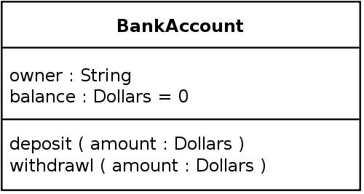
Basic Class Notation
Class name
Data
Methods

Slide 33
Visibility
Class members (data and methods) are preceded with symbols to indicate visibility
"+" Public
"-" Private
"#" Protected
"~" Package
"/" Derived (can be combined with one of the others)
Derived data is not stored
it is calculated e.g., age = date – birthdate), or
obtained in some other way (e.g., from an external sensor)

Slide 34
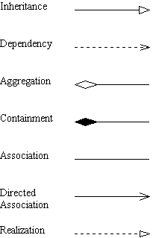
Relationships
Subtypes point to their parents with a hollow arrow (inheritance)
Components point to their containing (holder) with a diamond arrow
Hollow: Aggregation, part can exist alone
Solid: Containment, part cannot exist without holder
Other notations exist for other relationships

Slide 35
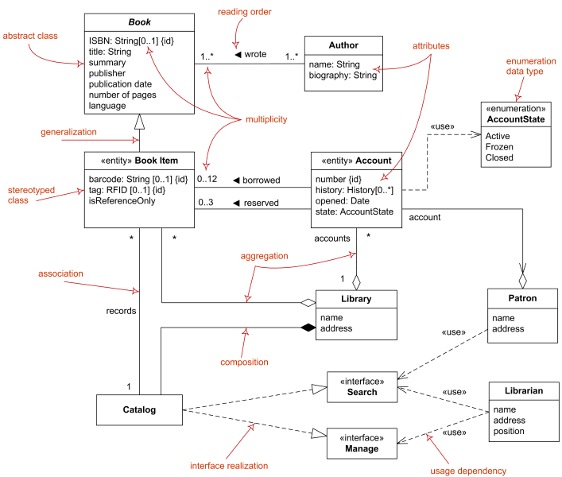

Slide 36
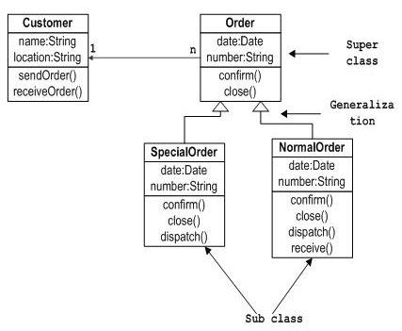
Class Diagram Example 1

Slide 37
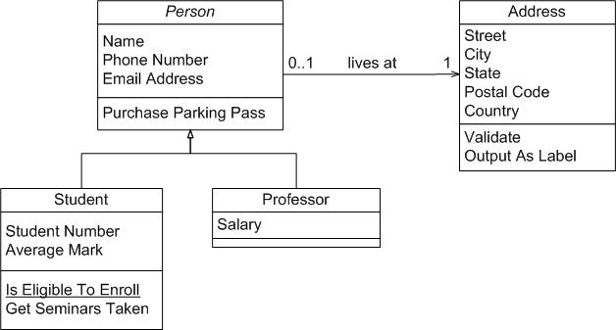
Class Diagram Example 2

Slide 38
Component Diagrams
Tutorials:
https://www.lucidchart.com/pages/uml-component-diagram
https://www.visual-paradigm.com/guide/uml-unified-modeling-language/what-is-component-diagram/
The purpose of a component diagram is to show the relationship between different components in a system.
In UML, the term "component" refers to a module of classes that represent independent systems or subsystems with the ability to interface with the rest of the system.
This is the level I want you to think at for the design phase.

Slide 39
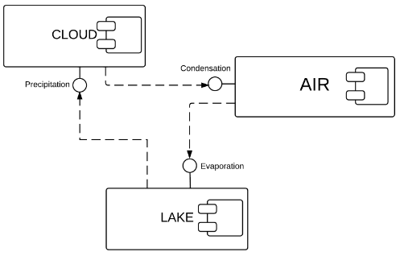
An Eco-system (things can be simple)

Slide 40
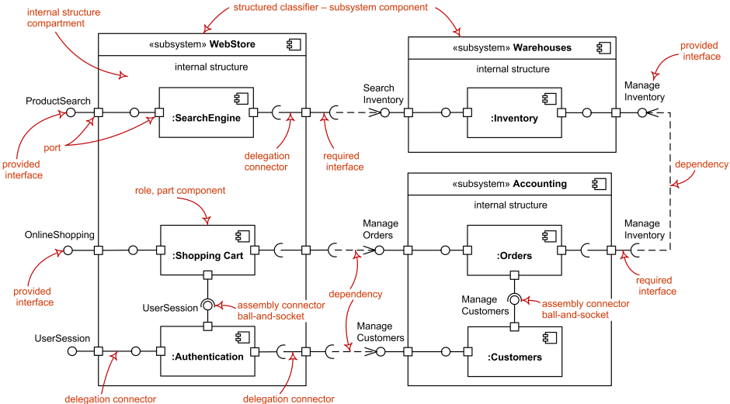
Some Notation …

Slide 41
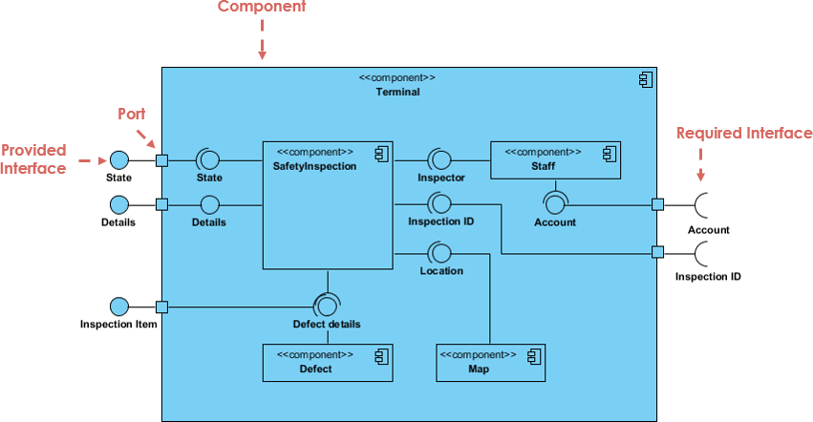
Another Example

Slide 42
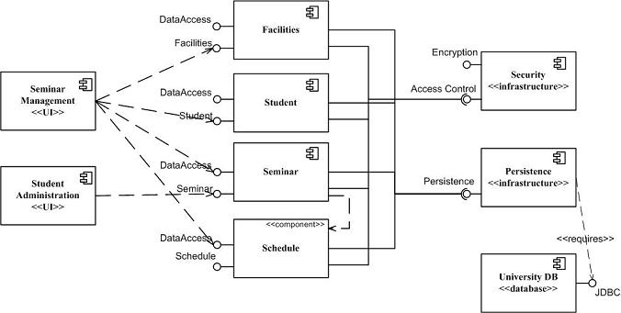
And yet another …

Slide 43
UML Behavioural Diagrams
Captures interactions among components and users
Explores execution, timing, sequencing, control flow, and other dynamic behaviour
Focus on functionality instead of structure
More of value in requirements analysis and specification phases
Can be used in the development of test plans

Slide 44
UML Behavioural Diagrams
Use Case Diagrams: Usage scenarios
Activity Diagrams: Flowcharts, step-by-step workflows
State Machine Diagrams: For systems where behaviour can be shown using state models
Interaction Overview Diagrams: Help show how other diagrams are related
Communication Diagrams: Interaction in terms of message sequences
Sequence Diagrams: Message passing and sequences
Timing Diagrams: For RT systems where explicit timing constraints exist

Slide 45
Effective Diagramming
Know your purpose – Modeling (complete, precise, detailed) vs. Communication (partial, concise, clear, focused)
Let your diagram speak when you can't – reference the diagram when something is hard to explain
Limit the number of abstractions in each diagram to 1
Don't feel limited by UML – if not using MDA then do whatever is needed to get the ideas across
Mix and match parts and pieces – abuse or ignore notation to achieve clarity

